Slide 1

MLDP PRESENTATION
NAME: CHEN XIN
ADMISSION NO: 2305105E
CLASS: PC04

Slide 2
Background of Dataset
Data Details:
Gender: Gender
Age: Age
Height : in metres
Weight : in kgs
family_history : Has a family member suffered or suffers from overweight?
FAVC : Do you eat high caloric food frequently?
FCVC : Do you usually eat vegetables in your meals?
NCP : How many main meals do you have daily?
CAEC : Do you eat any food between meals?
SMOKE : Do you smoke?
CH2O : How much water do you drink daily?
SCC : Do you monitor the calories you eat daily?
FAF: How often do you have physical activity?
TUE : How much time do you use technological devices such as cell phone, videogames, television, computer and others?
CALC : How often do you drink alcohol?
MTRANS : Which transportation do you usually use?
Obesity_level (Target Column) : Obesity level

Slide 3
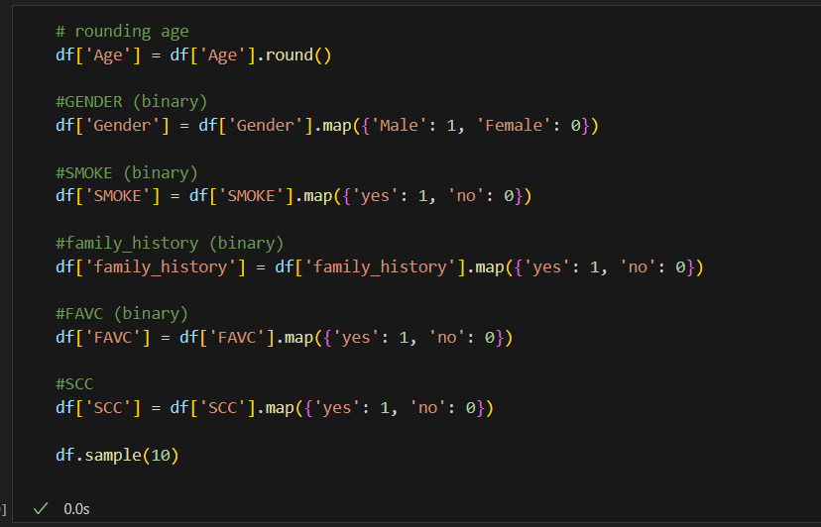
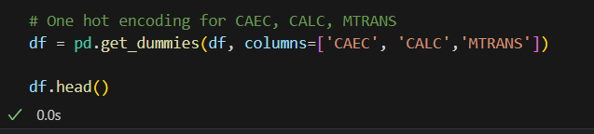
DATA PROCESSING STEPS
HANDLE MISSING VALUE
ONE HOT ENCODING
CHANGING TO BINARY

Slide 4
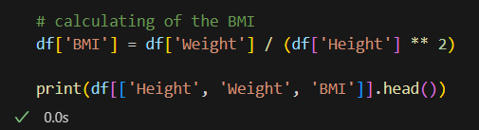
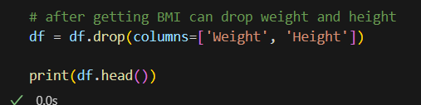
EXPLORATORY DATA ANALYSIS
CALCULATING THE BMI
DROPPING OF WEIGHT AND HEIGHT

Slide 5
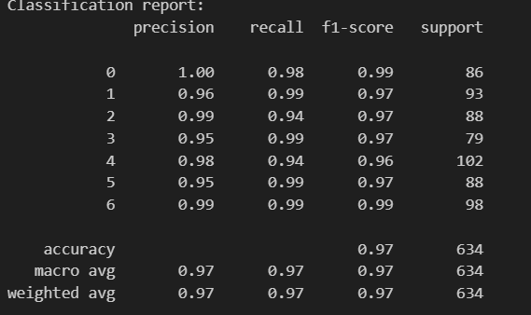
MODEL BUILDING
Chosen Models:
Random Forest Classifier (0.97)
Decision Tree Classifier (0.973)
Performance Metrics:
Precision
Recall
F1-Score.
Support

Slide 6
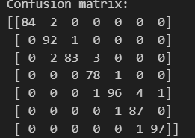
CONFUSION MATRIX & RESULTS
Rows = Actual classes.
Columns = Predicted classes.
Diagonal values = Correct predictions.
Off-diagonal values = Misclassifications.

Slide 7
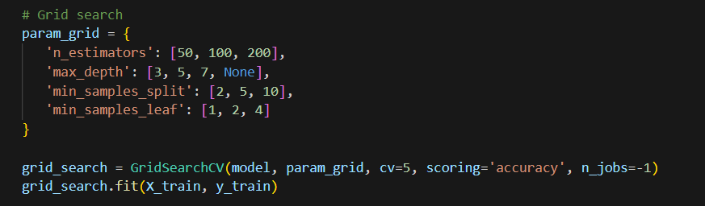
MODEL IMPROVEMENTS STEPS
Feature selection based on importance threshold.
Hyperparameter tuning of max depth, min samples split.

Slide 8
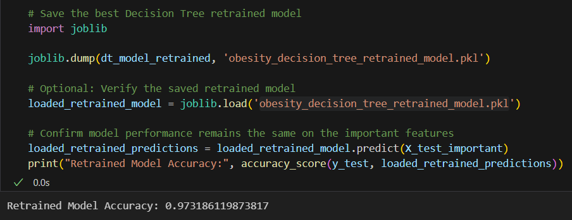
MODEL DEPLOYMENT
Exported the trained model using joblib.

Slide 9
ANY QUESTIONS?
THANK YOU! + Q&A

